Slide 1





Analysis of Current and Future Programming Language, Database, and Web Frame Trends
By Seth Marceno
December 5, 2020

Slide 2


OUTLINE
Executive Summary
Introduction
Methodology
Results
Visualization – Charts
Dashboard
Discussion
Findings & Implications
Conclusion
Appendix

Slide 3

EXECUTIVE SUMMARY
Programming Language desirability imply that JavaScript and HTML/CSS should continue to be the most popular with Python on the rise
Python is currently 5th most used but 3rd most desired for next year
Analysis of most popular databases shows PostgreSQL will overtake MySQL as most favorable next year
MySQL is losing popularity
We also see a rise in demand for MongoDB, which is 2nd most desired for next year
The top 4 platforms used currently are Windows, Linux, Docker, and AWS, which are also the top 4 desired for next year
Web Frame trends indicate the most used jQuery is falling in popularity and will be replaced by the likes of React.js, Vue.js, and Angular.js, which will potentially be most used

Slide 4

INTRODUCTION
The goal of this report is to gain insight as to what the most popular programming languages, databases, platforms, and web frames are today, and which services will be in the future.
One of the biggest challenges of business is staying ahead, or even up to date, on the changing landscape of the industry.
By exploring current usage of various languages, platforms, databases, and web frames as well as the desirability of different services for the future I hope to answer questions about where the industry is heading so that businesses can stay up to date.

Slide 5

METHODOLOGY
To perform our analysis, we used 3 Datasets
The first was a survey of developers that gave insight to what languages, databases, platforms and web frames that they currently used, as well as their most desired next year
By using GitHub API I was able to collect a table of the number of job postings that required certain programming languages.
Lastly using web scraping I obtained data describing the median salary paid to developers who used a each language.
Once the data was collected and cleaned, by imputing majority or median values for missing data I created a dashboard visualizing top languages and services currently used, and desired next year.

Slide 6
RESULTS
Top programming languages for the future will be JavaScript, HTML/CSS, and Python. (See slides 7 & 8)
Top databases will be PostgreSQL, MongoDB, and possibly Redis with a large increase in desirability form the previous year. (See slides 9 & 10)
Top platforms will continue to be Windows, Linux, Docker, and AWS in that order; however, we see a rise in demand for Linux, Docker, and AWS with a decline in demand for Windows. (See slides 12, 13, & 15)
Finally for the top web frames, jQuery is popular now, but is losing popularity fast. Expect web frames such as React.js, Vue.js, and Angular.js to be the most used. (See slides 12, 13, & 15)

Slide 7
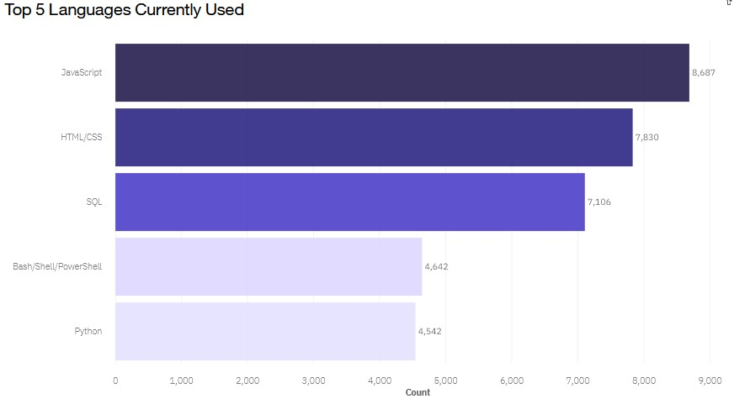
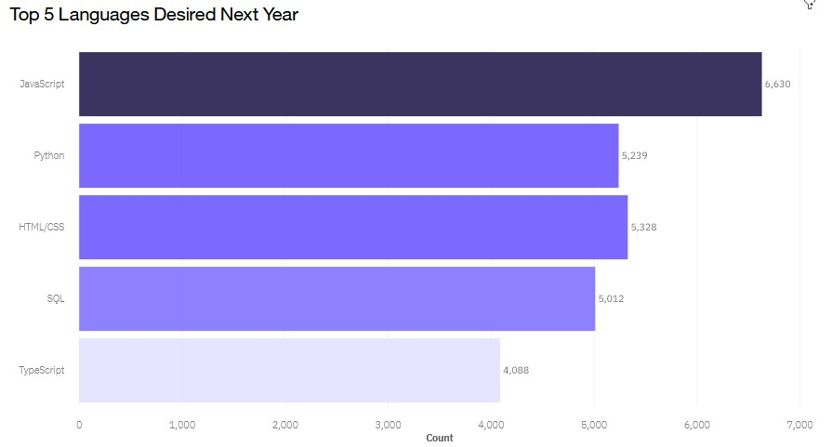
PROGRAMMING LANGUAGE TRENDS
Current Year
Next Year
<Bar chart of top 5 programming languages for the current year goes here.>
< Bar chart of top 5 programming languages for the next year goes here.>

Slide 8
PROGRAMMING LANGUAGE TRENDS - FINDINGS & IMPLICATIONS
Findings
JavaScript and HTML/CSS top both of the charts
Python is 5th currently but 3rd in desired next year
Bash/Shell/Powershell is fourth most popular but does not appear to be desired next year
Typescript appears to be fifth most desired language for next year
Implications
JavaScript and HTML/CSS should continue to be the most popular
Python Language is gaining popularity
Typescript is on the rise whereas Bash/Shell/Powershell seems to be losing popularity

Slide 9
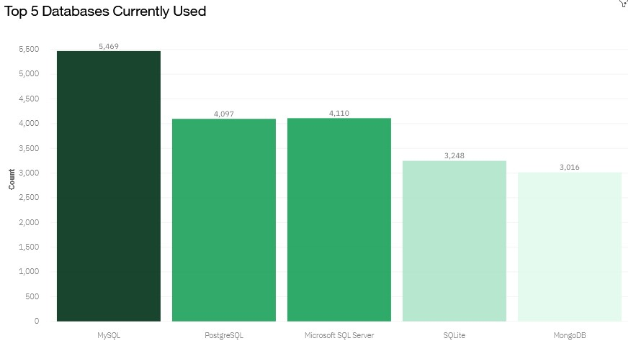
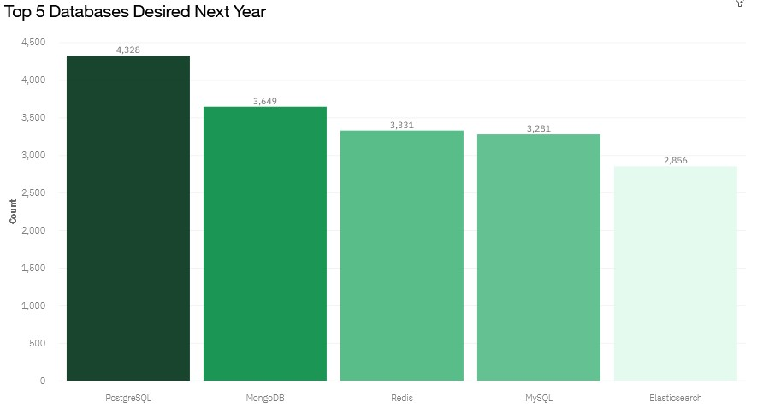
DATABASE TRENDS
Current Year
Next Year
< Bar chart of top 5 databases for the current year goes here >
< Bar chart of top 5 databases for the next year goes here.>

Slide 10
DATABASE TRENDS - FINDINGS & IMPLICATIONS
Findings
MongoDB places 5th currently but is 2nd most desired for next year
MySQL is most used currently but ranks 4th for desire next year
PostgreSQL is 2nd most popular now but most desired for next year
Implications
See a rise in demand for MongoDB
MySQL is losing popularity
In place of MySQL being most used, PostgreSQL looks to be the next most used database

Slide 11

DASHBOARD
Dashboard Link: Link

Slide 12
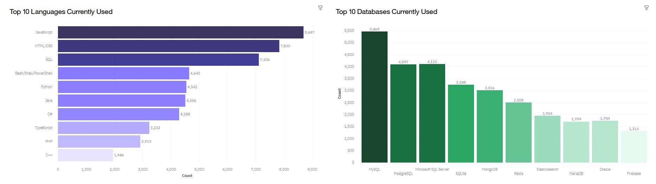
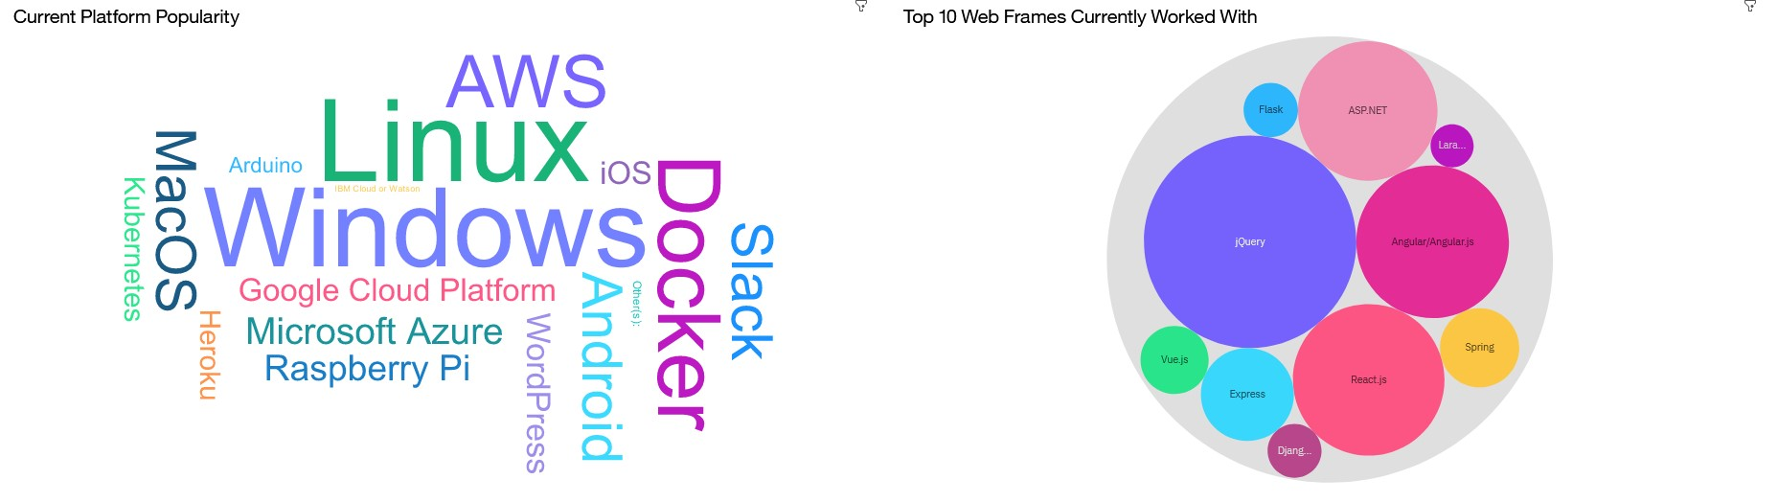
DASHBOARD TAB 1 – Current Trends
Screenshot of dashboard tab 1 goes here

Slide 13
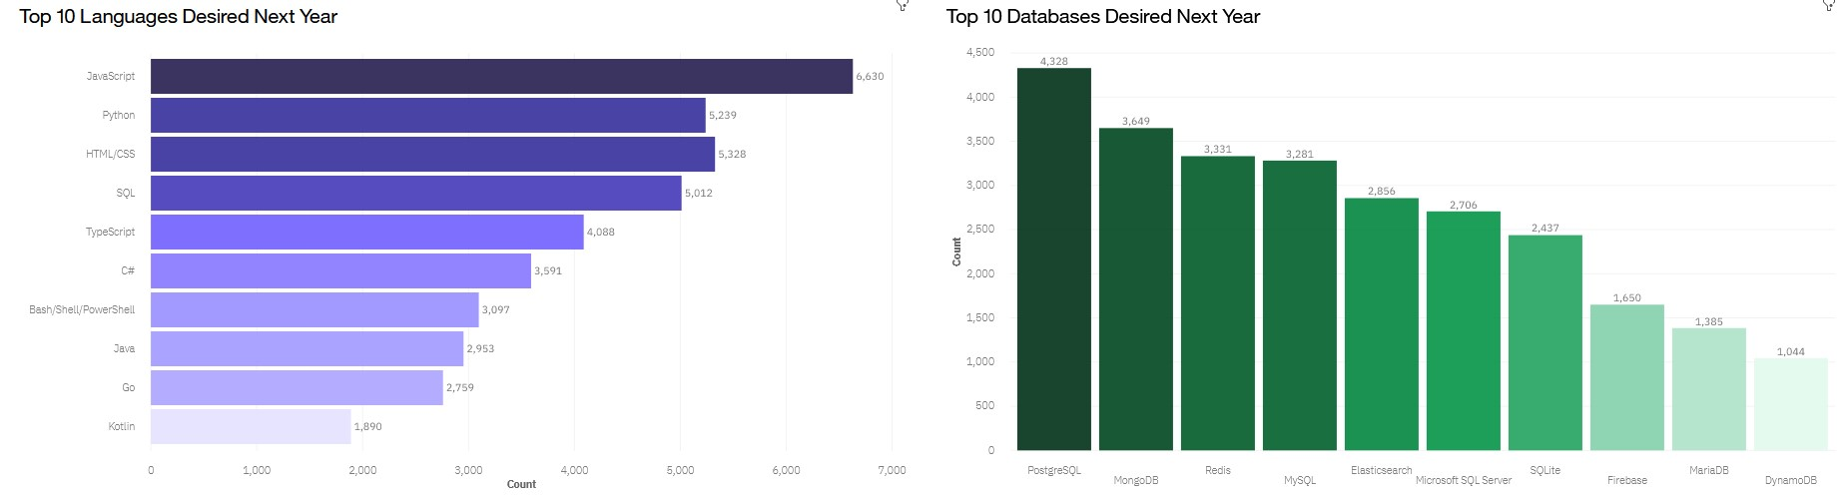
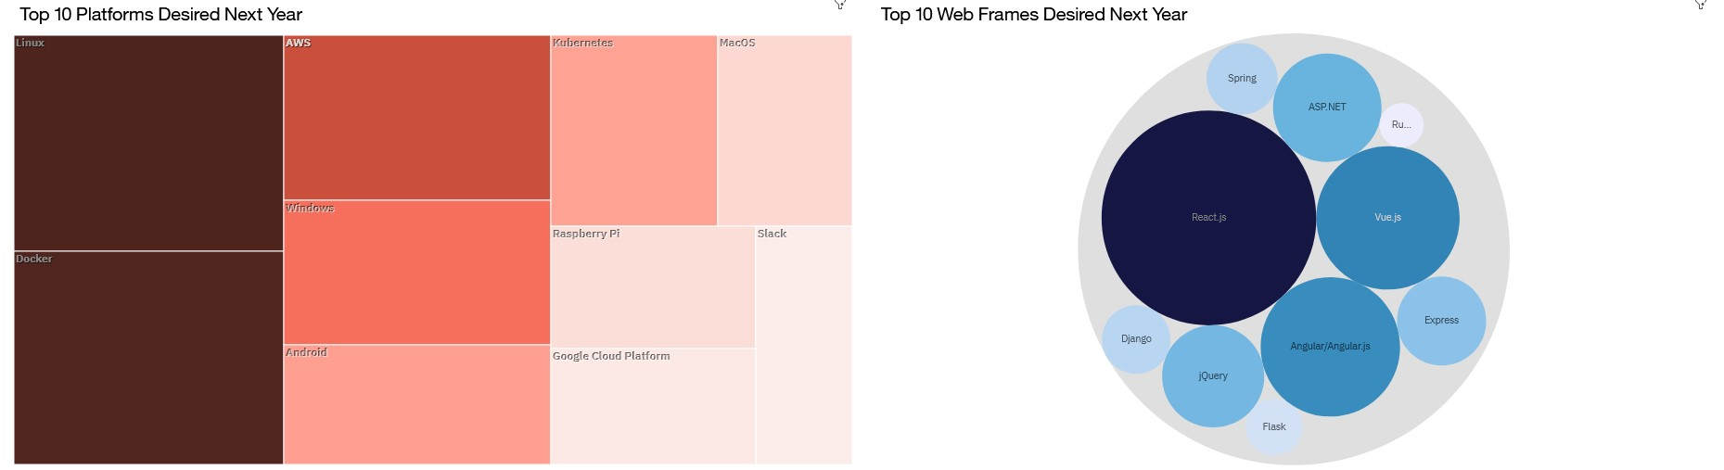
DASHBOARD TAB 2 – Future trends
Screenshot of dashboard tab 2 goes here

Slide 14
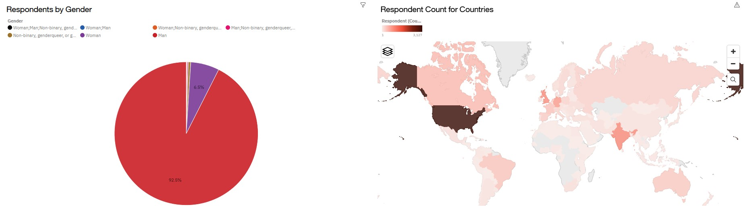
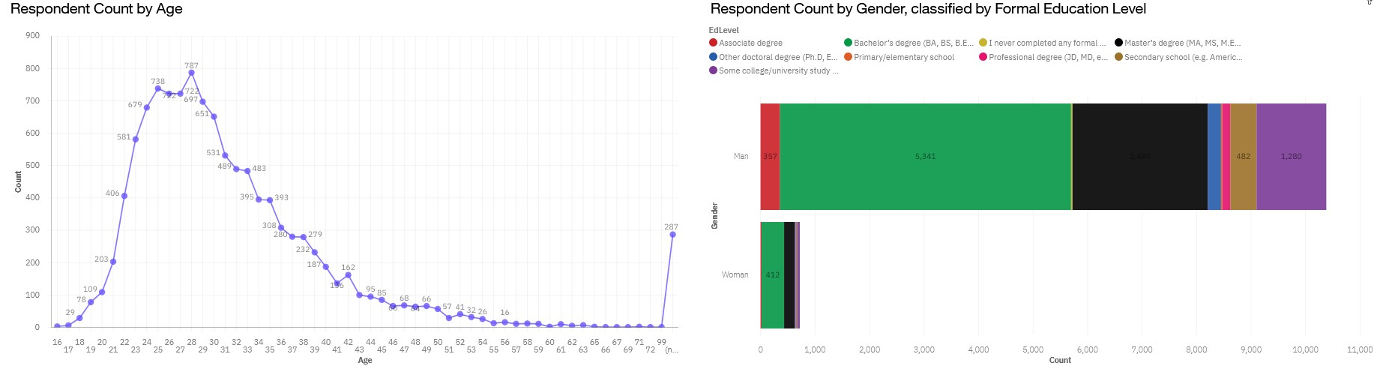
DASHBOARD TAB 3 - Demographics
Screenshot of dashboard tab 3 goes here

Slide 15
DISCUSSION
Looking at current and future trends we find the top languages and databases correspond to what we've previously seen
Additionally, Windows, Linux, and Docker will seemingly continue to be the top three platforms to work on, with AWS gaining popularity
Lastly, we see the web frame jQuery is popular now, but is losing popularity to web frames such as React.js, Vue.js, and Angular.js in the future
Based off the demographics tab we see the majority of respondents are Male, majority aged 25-35, with a Bachelor's Degree

Slide 16
OVERALL FINDINGS & IMPLICATIONS
Findings
JavaScript and HTML/CSS languages are chart toppers for both current and future desirability, with Python at 3rd
MySQL is most desired now but losing to PostgreSQL and MongoDB for most desired next year
The top platforms currently are Windows, Linux, Docker, and AWS with these also being the top desired for next year
Lastly, we see the web frame jQuery is most popular now, but is not very desired for next year
Implications
JavaScript and HTML/CSS are here to stay, with Python gaining popularity
MySQL is losing popularity and is being replaced by PostgreSQL and MongoDB
Platform popularity doesn’t seem to be changing too much; however, we see a rise in desire for Linux, Docker, and AWS, whereas Windows demand for next year comes in 4th
jQuery is popular now, but is losing popularity to web frames such as React.js, Vue.js, and Angular.js, which will potentially be most used

Slide 17

CONCLUSION
Most popular languages moving forward will be JavaScript, HTML/CSS, and Python
Most popular database will be PostgreSQL, most likely followed by MongoDB, MySQL, and Redis
The platforms Linux, Windows, Docker, and AWS will continue to be most widely used
Web Frames such as React.js, Vue.js, and Angular.js will overtake jQuery as most used Web Frames

Slide 18
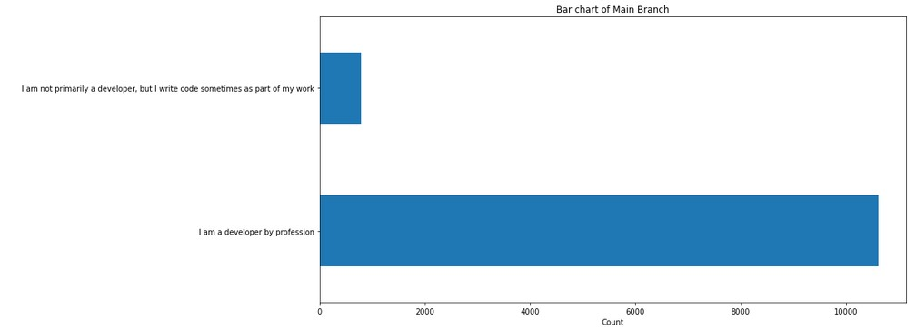

APPENDIX
Include any relevant additional charts, or tables that you may have created during the analysis phase.
Here we can see the distribution of code users that can give insight into whose preferences we are analyzing

Slide 19
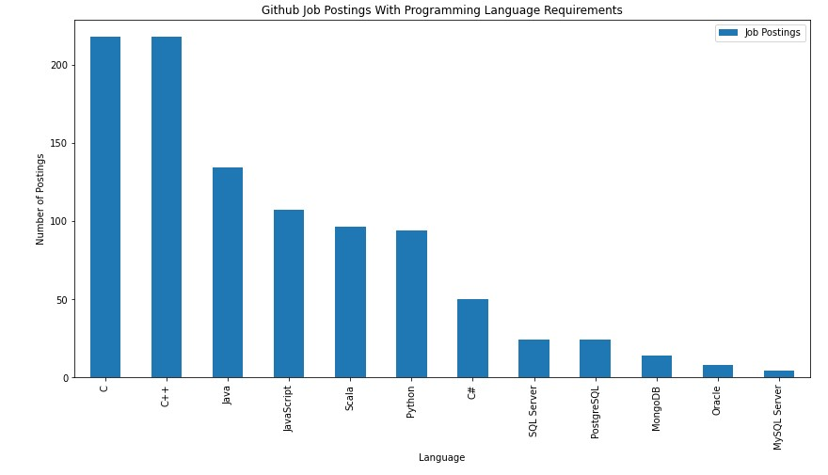
GITHUB JOB POSTINGS
218
218
In Module 1 you have collected the job postings data using GitHub API in a file named “github-job-postings.xlsx”. Present that data using a bar chart here. Order the bar chart in the descending order of number of job postings.
134
107
96
94
50
24
24
14
8
4

Slide 20
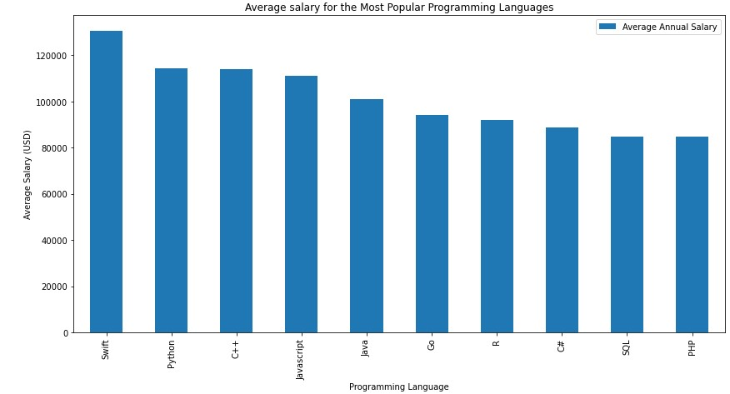
POPULAR LANGUAGES
$130,801
$114,383
$113,865
$110,981
In Module 1 you have collected the job postings data using web scraping in a file named “popular-languages.csv”. Present that data using a bar chart here. Order the bar chart in the descending order of salary.
$101,013
$94,082
$92,037
$88,726
$84,793
$84,727

